Slide 1
Dissertation workshop
Laura Richards-Gray
PGT Education Lead School of Social Science
l.richards-gray@bbk.ac.uk

Slide 2
What we’ll cover
Overview of process, timings
What's a dissertation? And different approaches
Identifying & working with a supervisor
What makes a good research Q?
What makes a good dissertation? (and common issues)
Q&A

Slide 3
Process & timings

Slide 4
Process…
Access dissertation Moodle pages
Read guidelines/ sample dissertations & think about your topic
Identify potential supervisor
Complete & submit proposal form
Meet with supervisor (early 2nd term)
Apply for ethics clearance if needed

Slide 5
Key dates
Those beginning Oct 2024 FT and Oct 2023 PT
Proposal submission 15th Jan 2025
Dissertation deadline 15th September 2025
Those beginning Oct 2024 PT
Proposal submission Jan 2026
Dissertation deadline September 2026
Those beginning Jan 2024 PT
Proposal submission May 2025
Dissertation submission Jan 2026
Those beginning Jan 2024 FT
Proposal submission was 1st May 2024
Dissertation submission 15th Jan 2025

Slide 6
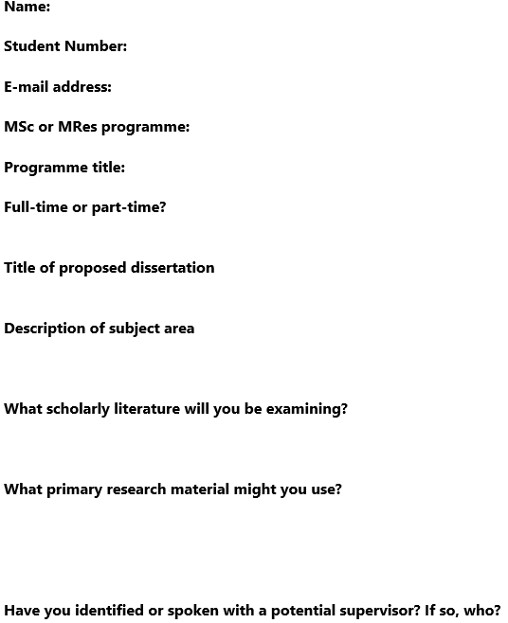
The form…
On Moodle

Slide 7
The dissertation

Slide 8
What’s a dissertation
A requirement for completion of all the MSc programmes – and a 3rd of your degree!
A long written piece of research between 12,000-15,000 words (incl. all footnotes, references and appendices)
An independent (albeit supervised) research project on a chosen topic
Students should demonstrate they have examined a subject in substantial depth and developed understanding of their topic
Critical analysis and demonstration of research skills are key
It is not enough simply to review the books and articles which you have collected on the topic – must have an element of your own research

Slide 9
Different approaches
Typically follow one of four approaches:
a case study to assess, explore, validate or critically examine an argument, theory or theoretical perspective in the literature;
a comparative study where a process, development or institution is examined in two or more settings;
quant or qual data is used to test an existing hypothesis or to form a new one (can be existing or new data – the latter will require ethics);
a critical analysis of a theoretical argument or perspective that engages closely with primary texts
So, method can involve:
original analysis of primary sources(letters, diaries, gov records, speeches, original texts) or secondary sources (newspaper articles, biographies, books etc.);
secondary analysis of existing qualitative or qualitative data (existing statistics or interview data etc.);
or collection & analysis of new qual or quant data (through surveys, interviews, focus groups etc.)

Slide 10
Finding & working with a supervisor

Slide 11
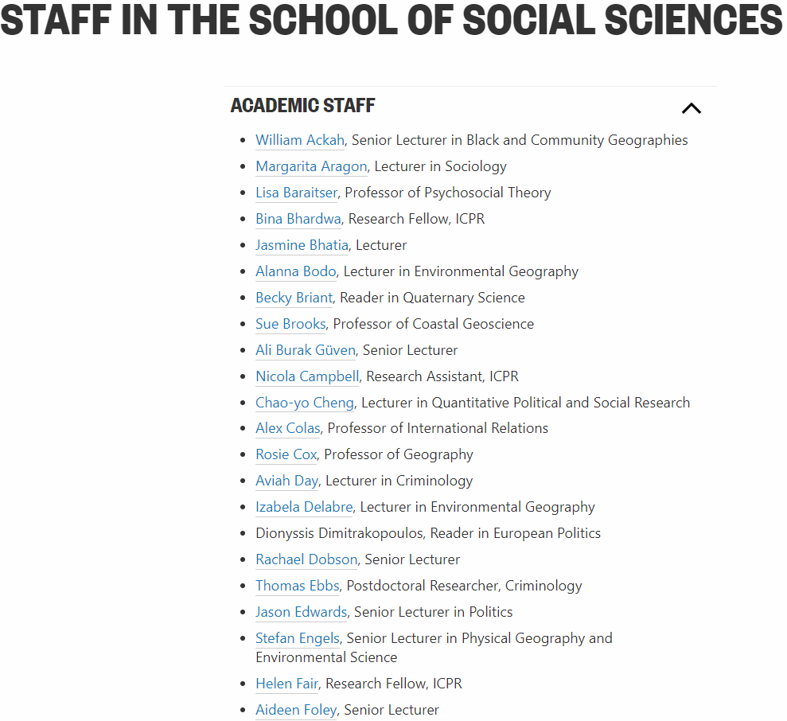

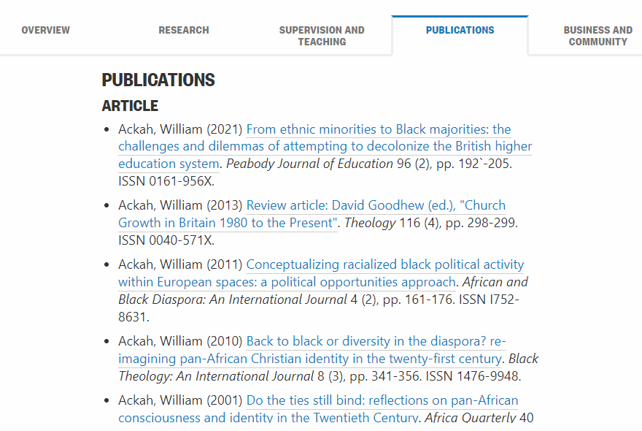
Identifying a supervisor https://www.bbk.ac.uk/school/social-sciences/our-staff

Slide 12


Role of the supervisor
Guidance (on topic, question, methodology, organisation etc.)
Guidance on preliminary reading
Advice & feedback on ethics approval if needed
General advice on problem solving, presentation etc.
Meet with you at least three times (excl. over the summer)
Read and feedback on outline + 1 draft ch. or equivalent, up to 20%
BUT…
Under no obligation to read full drafts
Not their role to direct the research or ensure that a dissertation is of sufficient quality to pass; this is the responsibility of the student

Slide 13
Topics & questions

Slide 14
Developing research questions
Topic: What am I interested in?
Research Question(s)
Sub-Questions?
What data?
Method?
Refine: Add time frame? Location?

Slide 15
The research topic > research Q
Topic = what you are studying
Question = what you are trying to find out
Start broad – what’s the puzzle/area are you interested in?
Then narrow down to something more specific
Then refine scope further to make it researchable (e.g. location, specific time-frame, case study and/or other area of interest)
Then, what is it you actually want to know? Posed as a Q!
Think about a research topic. Start broad and refine. Can you sum it up in a sentence? Write it down…

Slide 16
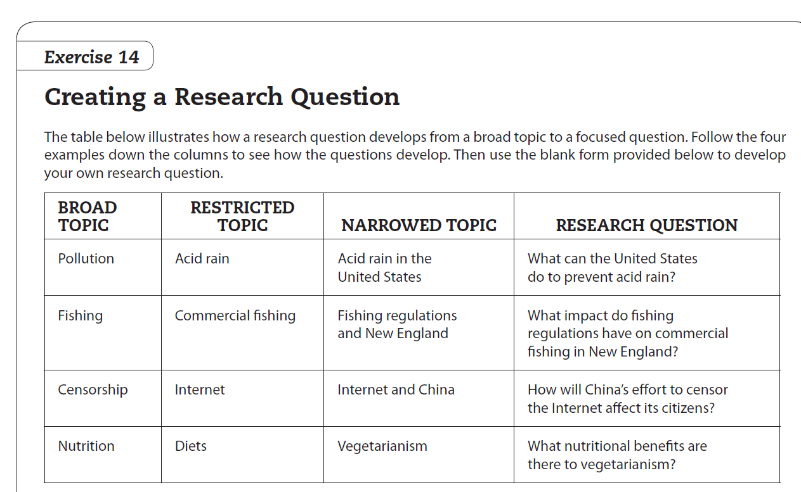

Slide 17
What makes a good question
Clear and easy to understand – should be understandable to someone with no prior knowledge
Makes a contribution to the literature. Has anyone else answered this? Have they answered it well?
Is answerable! (consider what methods you’d use)
Is it interesting? Does it matter? (“So what?”)
In short: suitably focused to be researchable, but broad enough to make a reasonable contribution
Write down a couple of research questions related to your topic? What are you interested in finding out?

Slide 18
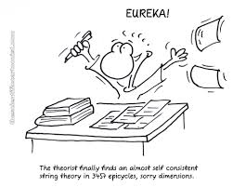
Where do research questions come from?
Curiosity: Wanting to discover/ explain something
A hypothesis: Maybe you have an idea about the way something works and want to test it?
Reading: Identify what is already known/ still to be discovered
Feedback: Discuss your ideas with others.

Slide 19
Ingredients for a good dissertation

Slide 20
Key ingredients
Definition of research question, argument or hypothesis
Consideration of alternative arguments, knowledge of relevant issues and debates
Critical vs descriptive approach
Appropriateness of methodology, quality of evidence
Use of relevant sources, knowledge of relevant literature
Style and presentation
60-69: A good dissertation, which offers a precise specification of the research question, presents a clear and coherent argument that is well-substantiated by evidence, treats the issues in a critical and balanced way, shows an awareness of context, sources and different explanations, and achieves a high standard of presentation
70-79: A dissertation of distinction quality, which addresses a well-defined research question, displays exceptional knowledge of the literature and/or a substantial measure of originality, and achieves a high standard of presentation.
80-100: A dissertation of distinction quality, which is outstanding in virtually all areas. Contains substantial evidence of original and independent thought.

Slide 21
Common problems
PROBLEM: No clear question or not answering the question
SOLUTION: Discuss with your supervisor & focus your analysis on the Q throughout
PROBLEM: No clear argument
SOLUTION: Answer the question! Plan what you are going to say before writing & state your core argument upfront
PROBLEM: Lack of analysis – just describing what texts say (especially in the Lit Rev)
SOLUTION: Explain and evaluate different points/arguments; use the Lit Rev to map the literature & explain your contribution
PROBLEM: Poor grammar, spelling, sentence construction
SOLUTION: Proofread (aloud!)

Slide 22
Finally, to note on plagiarism & AI…

Slide 23
Plagiarism
What is it? – Passing off others’ ideas as you own without citing
Replicating text from books without placing in quotation marks & citing
Paraphrasing without citing the ideas
Self-plagiarising i.e. resubmitting work that’s already been assessed
Commissioning others to do your essay for you
Copying work submitted by another student
Copying text or ideas from online essay sites

Slide 24
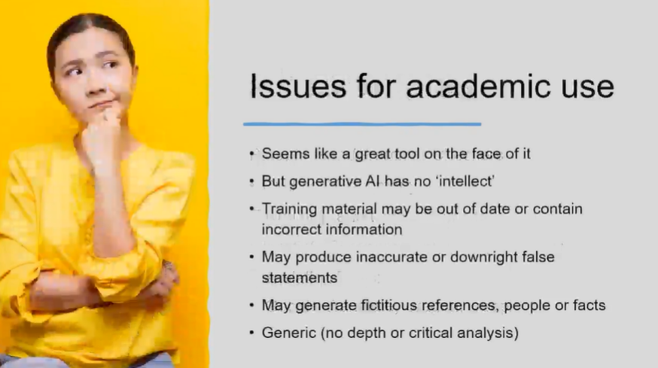
AI?
Useful video on AI use: AI and your assessments
Academic Integrity Policy: Here; AI appendix: Here

